Slide 1
计算机网络 复习
徐敬东 张建忠
xujd@nankai.edu.cn
zhangjz@nankai.edu.cn
计算机网络与信息安全研究室
计算机学院&网络空间安全学院

Slide 2






第一章
计算机网络的构成及基本概念
Internet发展历程
网络协议与TCP/IP体系结构
Internet的核心与边缘
FTP服务器访问示例

Slide 3

















第二章
应用协议与进程通信模型
传输层服务对应用的支持
文件传输服务与协议
Web服务与协议
电子邮件服务与协议
域名服务与协议
对等通信
网络编程方法

Slide 4









第三章
传输层需要解决的基本问题
TCP/IP体系结构中传输层协议与服务
用户数据报协议（UDP）
可靠数据传输
传输控制协议（TCP）
理解网络拥塞
TCP拥塞控制机制

Slide 5







第四章
网络层功能
IP协议
IPv4数据包格式和地址
IPv4数据包转发
IPv4地址问题及解决策略
IPv6基础
ICMP协议
路由算法
链路状态算法
距离向量算法
互联网路由协议：RIP, OSPF, BGP
软件定义网络（SDN）

Slide 6
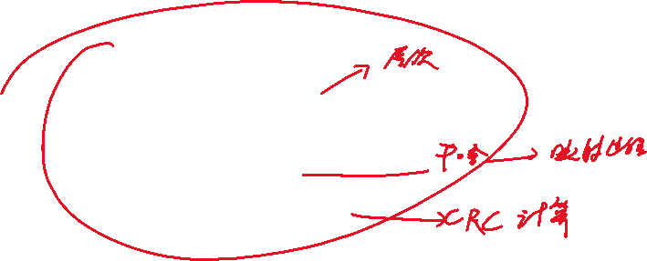




第五章
接口层基础
局域网体系结构与组网方法
局域网编址与ARP协议
链路层差错控制
共享式以太网
交换式以太网
虚拟局域网
无线局域网

Slide 7




HTTP
HTTP
TCP
IP
Eth
Phy
web page finally (!!!) displayed
HTTP
HTTP
HTTP
HTTP
HTTP
HTTP
HTTP
HTTP
HTTP request sent into TCP socket
IP datagram containing HTTP request routed to www.google.com
router
(runs DHCP)
HTTP
HTTP
TCP
IP
Eth
Phy
HTTP
HTTP
web server responds with HTTP reply (containing web page)
HTTP
HTTP
web server
IP datagram containing HTTP reply routed back to client
64.233.169.105

Slide 8

browser
DNS server
ISP network
68.80.0.0/13
school network
68.80.2.0/24
web page
web server
Google’s network
64.233.160.0/19
64.233.169.105

Slide 9
DHCP
DHCP
UDP
IP
Eth
Phy
connecting laptop needs to get its own IP address, addr of first-hop router, addr of DNS server: use DHCP
DHCP
DHCP
DHCP
DHCP
DHCP request encapsulated in UDP, encapsulated in IP, encapsulated in 802.3 Ethernet
DHCP
DHCP
UDP
IP
Eth
Phy
DHCP
DHCP
DHCP
DHCP
router
(runs DHCP)
Ethernet frame broadcast (dest: FFFFFFFFFFFF) on LAN, received at router running DHCP server
Ethernet demuxed to IP demuxed, UDP demuxed to DHCP

Slide 10

DHCP server formulates DHCP ACK containing client’s IP address, IP address of first-hop router for client, name & IP address of DNS server
DHCP
DHCP
UDP
IP
Eth
Phy
DHCP
DHCP
DHCP
encapsulation at DHCP server, frame forwarded (switch learning) through LAN, demultiplexing at client
DHCP
DHCP
UDP
IP
Eth
Phy
DHCP
DHCP
DHCP
router
(runs DHCP)
DHCP
DHCP client receives DHCP ACK reply
Client now has IP address, knows name & addr of DNS
server, IP address of its first-hop router

Slide 11

DNS
UDP
IP
Eth
Phy
before sending HTTP request, need IP address of www.google.com: DNS
DNS
DNS
DNS
ARP
ARP query
DNS query created, encapsulated in UDP, encapsulated in IP, encapsulated in Eth. To send frame to router, need MAC address of router interface: ARP
ARP
ARP reply
Eth
Phy
router
(runs DHCP)
ARP query broadcast, received by router, which replies with ARP reply giving MAC address of router interface
client now knows MAC address of first hop router, so can now send frame containing DNS query

Slide 12

DNS
UDP
IP
Eth
Phy
DNS
DNS server
DNS
UDP
IP
Eth
Phy
DNS
DNS
DNS
DNS
DNS
DNS
DNS
DNS
ISP network
68.80.0.0/13
IP datagram forwarded from campus network into Internet, routed (tables created by RIP, OSPF and/or BGP routing protocols) to DNS server
router
(runs DHCP)
IP datagram containing DNS query forwarded via LAN switch from client to 1st hop router
demux’ed to DNS server
DNS server replies to client with IP address of www.google.com

Slide 13
HTTP
HTTP
TCP
IP
Eth
Phy
SYNACK
SYN
SYNACK
SYN
SYNACK
SYN
SYN
to send HTTP request, client first opens TCP socket to web server
router
(runs DHCP)
TCP SYN segment (step 1 in 3-way handshake) inter-domain routed to web server
TCP
IP
Eth
Phy
SYNACK
SYN
SYNACK
SYN
SYNACK
web server responds with TCP SYNACK (step 2 in 3-way handshake)
SYNACK
SYN
web server
TCP connection established!
64.233.169.105

Slide 14
HTTP
HTTP
TCP
IP
Eth
Phy
web page finally (!!!) displayed
HTTP
HTTP
HTTP
HTTP
HTTP
HTTP
HTTP
HTTP
HTTP request sent into TCP socket
IP datagram containing HTTP request routed to www.google.com
router
(runs DHCP)
HTTP
HTTP
TCP
IP
Eth
Phy
HTTP
HTTP
web server responds with HTTP reply (containing web page)
HTTP
HTTP
web server
IP datagram containing HTTP reply routed back to client
64.233.169.105

Slide 15


